Slide 1
ADT Implementation: Recursion, Algorithm Analysis, and Standard Algorithms
Chapter 10

Slide 2
Chapter Contents
10.1 Recursion
10.2 Examples of Recursion: Towers of Hanoi; Parsing
10.3 Implementing Recursion
10.4 Algorithm Efficiency
10.5 Standard Algorithms in C++
10.6 Proving Algorithms Correct (Optional)

Slide 3
Chapter Objectives
Review recursion by looking at examples
Show how recursion is implemented using a run-time stack
Look at the important topic of algorithm efficiency and how it is measured
Describe some of the powerful and useful standard C++ function templates in STL
(Optional) Introduce briefly the topic of algorithm verification

Slide 4
Recursion
A function is defined recursively if it has the following two parts
An anchor or base case
  The function is defined for one or more specific values of the parameter(s)
An inductive or recursive case
  The function's value for current parameter(s) is defined in terms of previously defined function values and/or parameter(s)

Slide 5
Recursive Example
Consider a recursive power function
double power (double x, unsigned n)
{ if ( n == 0 )
return 1.0;
else
return x * power (x, n-1); }
Which is the anchor?
Which is the inductive or recursive part?
How does the anchor keep it from going forever?

Slide 6
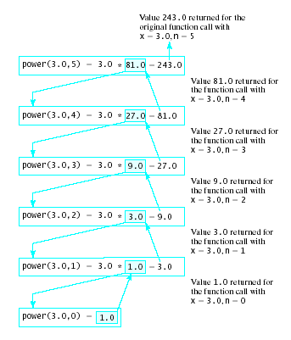
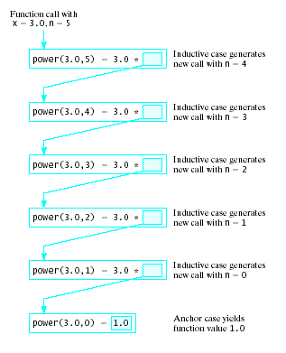
Recursive Example
Note the
results of
a call
  Recursive
  calls
  Resolution
  of the
  calls

Slide 7
A Bad Use of Recursion
Fibonacci numbers
1, 1, 2, 3, 5, 8, 13, 21, 34
f₁ = 1, f₂ = 1 … f_{n} = f_{n -2} + f_{n -1}
  A recursive function
  double Fib (unsigned n)
  { if (n <= 2) return 1;
  else
  return Fib (n – 1) + Fib (n – 2); }

Slide 8
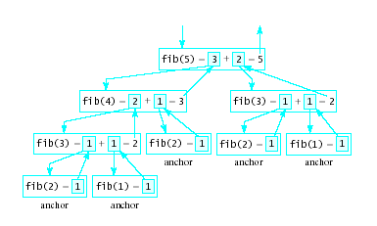
A Bad Use of Recursion
Why is this inefficient?
  Note the recursion tree
Nyhoff, ADTs, Data Structures and Problem Solving with C++, Second Edition, © 2005 Pearson Education, Inc. All rights reserved. 0-13-140909-3

Slide 9
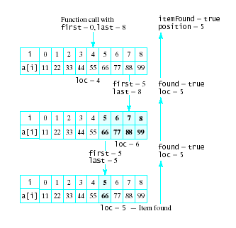
Uses of Recursion
Binary Search
  See source code
  Note results of
  recursive call

Slide 10
Uses of Recursion
Palindrome checker
  A palindrome has same value with characters reversed
  1234321 racecar
Recursive algorithm for an integer
  If numDigiths <= 1 return true
  Else check first and last digits
  num/10^{numDigits-1} and num % 10
    if they do not match return false
  If they match, check more digits
  Apply algorithm recursively to:
  num % 10^{numDigits-1} and numDigits - 2

Slide 11
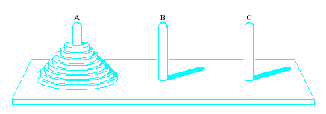
Recursion Example:
Towers of Hanoi
Recursive algorithm especially appropriate for solution by recursion
Task
  Move disks from left peg to right peg
  When disk moved, must be placed on a peg
  Only one disk (top disk on a peg) moved at a time
  Larger disk may never be placed on a smaller disk

Slide 12
Recursion Example:
Towers of Hanoi
Identify base case:
If there is one disk move from A to C
Inductive solution for n > 1 disks
  Move topmost n – 1 disks from A to B, using C for temporary storage
  Move final disk remaining on A to C
  Move the n – 1 disk from B to C using A for temporary storage
View code for solution, Fig 10.4

Slide 13
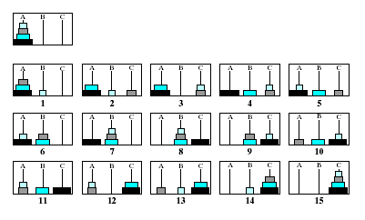
Recursion Example:
Towers of Hanoi
Note the graphical steps to the solution

Slide 14
Recursion Example: Parsing
Examples so far are direct recursion
  Function calls itself directly
Indirect recursion occurs when
  A function calls other functions
  Some chain of function calls eventually results in a call to original function again
An example of this is the problem of processing arithmetic expressions

Slide 15
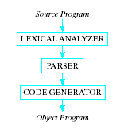
Recursion Example: Parsing
Parser is part of the compiler
Input to a compiler is
characters
  Broken up into meaningful groups
  Identifiers, reserved words, constants, operators
These units are called tokens
  Recognized by lexical analyzer
  Syntax rules applied

Slide 16
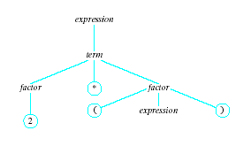
Recursion Example: Parsing
Parser generates a
parse tree using the
tokens according to
rules below:
An expression:
term + term | term – term | term
A term:
factor * factor | factor / factor | factor
A factor:
( expression ) | letter | digit
Note the indirect recursion

Slide 17
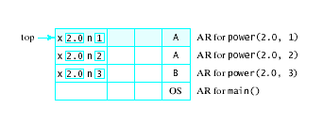
Implementing Recursion
Recall section 7.4, activation record created for function call
Activation records placed on run-time stack
Recursive calls generate stack of similar activation records

Slide 18
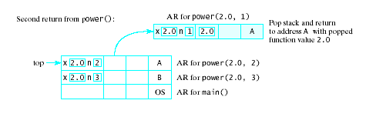
Implementing Recursion
When base case reached and successive calls resolved
  Activation records are popped off the stack

Slide 19
Algorithm Efficiency
How do we measure efficiency
  Space utilization – amount of memory required
  Time required to accomplish the task
Time efficiency depends on :
  size of input
  speed of machine
  quality of source code
  quality of compiler
These vary from one platform to another

Slide 20
Algorithm Efficiency
We can count the number of times instructions are executed
  This gives us a measure of efficiency of an algorithm
So we measure computing time as:
T(n) = computing time of an algorithm for input of size n
= number of times the instructions are executed

Slide 21
Example: Calculating the Mean
Task # times executed
Initialize the sum to 0 1
Initialize index i to 0 1
While i < n do following n+1
a) Add x[i] to sum n
b) Increment i by 1 n
Return mean = sum/n 1
Total 3n + 4

Slide 22
Computing Time Order of Magnitude
As number of inputs increases
  T(n) = 3n + 4 grows at a rate proportional to n
Thus T(n) has the "order of magnitude" n
The computing time of an algorithm on input of size n,
  T(n) said to have order of magnitude f(n),
  written T(n) is O(f(n))
if … there is some constant C such that
  T(n) < Cf(n) for all sufficiently large values of n

Slide 23
Big Oh Notation
Another way of saying this:
The complexity of the algorithm is O(f(n)).
Example: For the Mean-Calculation Algorithm:
T(n) is O(n)
Note that constants and multiplicative factors are ignored.

Slide 24
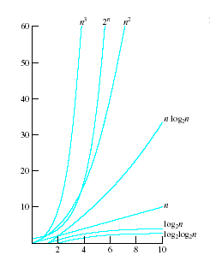
Big Oh Notation
f(n) is usually simple:
n, n², n³, ...
2n
1, log₂n
n log₂n
log₂log₂n
Note graph
of common
computing times

Slide 25
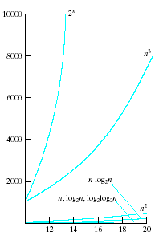
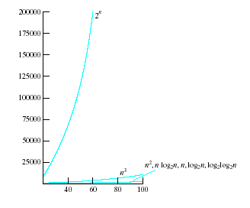
Big Oh Notation
Graphs of common computing times

Slide 26
Common Computing Time Functions
log₂log₂n | log₂n | n | n log₂n | n² | n³ | 2^{n}
--- | 0 | 1 | 0 | 1 | 1 | 2
0.00 | 1 | 2 | 2 | 4 | 8 | 4
1.00 | 2 | 4 | 8 | 16 | 64 | 16
1.58 | 3 | 8 | 24 | 64 | 512 | 256
2.00 | 4 | 16 | 64 | 256 | 4096 | 65536
2.32 | 5 | 32 | 160 | 1024 | 32768 | 4294967296
2.58 | 6 | 64 | 384 | 4096 | 262144 | 1.84467E+19
3.00 | 8 | 256 | 2048 | 65536 | 16777216 | 1.15792E+77
3.32 | 10 | 1024 | 10240 | 1048576 | 1.07E+09 | 1.8E+308
4.32 | 20 | 1048576 | 20971520 | 1.1E+12 | 1.15E+18 | 6.7E+315652

Slide 27
Computing in Real Time
Suppose each instruction can be done in 1 microsecond
For n = 256 inputs how long for various f(n)
Function
log₂log₂n
Log₂n
n
n log₂n
n²
n³
2^{n}
Nyhoff, ADTs, Data Structures and Problem Solving with C++, Second Edition, © 2005 Pearson Education, Inc. All rights reserved. 0-13-140909-3

Slide 28
STL's Algorithms
STL has a collection of more than 80 generic algorithms.
  not member functions of STL's container classes
  do not access containers directly.
They are stand-alone functions
  operate on data by means of iterators .
Makes it possible to work with regular C-style arrays as well as containers.

Slide 29
Example of sort Algorithm
Comes in several different forms
One uses the < operator to compare elements
  Requires that operator<() be defined on the data type being sorted
  Example program, Fig 10.7
The sort algorithm can be used with arrays
  See example, Fig. 10.8
Sort algorithm can have a third parameter
  The name of a boolean function to be used for a less than
  See Fig. 10.9

Slide 30
A Sample of STL Algorithms
Designed to operate on a sequence of elements
Designate a sequence by using two iterators
  One positioned at the first element of the sequence
  One positioned after the last element in the sequence
Note Table 10-4, Page 583 of text

Slide 31
Algorithms from <numeric> Library
Contains function templates that operate on sequential containers
Intended for use with numeric sequences
  Such as valarrays
See Table 10-5, page 584

Slide 32
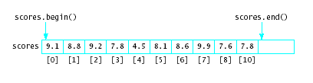
Using Algorithms
Consider the judging of figure skaters
  When judges give scores the high and low score are discarded
  Then the remaining scores are averaged
Given the vector of scores shown below
Nyhoff, ADTs, Data Structures and Problem Solving with C++, Second Edition, © 2005 Pearson Education, Inc. All rights reserved. 0-13-140909-3

Slide 33
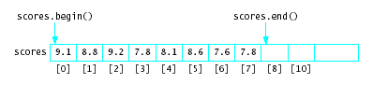
Using Algorithms
Use min_element algorithms to find and discard minimum score
scores.erase(min_element(scores.begin(),
scores.end())));
Discard maximum element similarly
Now use accumulate() algorithm
double avg = accumulate(scores.begin(),
scores.end(),0.0)/scores.size();
Nyhoff, ADTs, Data Structures and Problem Solving with C++, Second Edition, © 2005 Pearson Education, Inc. All rights reserved. 0-13-140909-3

Slide 34
Proving Algorithms Correct
Deductive proof of correctness may be required
  In safety-critical systems where lives at risk
Must specify
  The "given" or preconditions
  The "to show" or post conditions
  Pre and Algorithm => Post

Slide 35
Example: Recursive Power Function
Function:
double power (double x, unsigned n)
{ if ( n == 0 )
return 1.0;
else
return x * power (x, n-1); }
Precondition:
  Input consists of a real number x and a nonnegative integer n
Postcondition:
  Execution of function terminates
  When it terminates value returned is x^{n}

Slide 36
Example: Recursive Power Function
Use mathematical induction on n
  Show postcondition follows if n = 0
Assume for n = k, execution terminates and returns correct value
  When called with n = k + 1, inductive case
  return x * power (x, n – 1) is executed
  Value of n – 1 is k
  It follows that with n = k + 1, returns x * x^{k}
  which equals x^{k+1}

Slide 37
Proving Algorithms Correct
Notation could be used to state assertions
Pre { Post = Pre (v, e ) }
"If precondition Pre holds before an assignment statement S of the form v = e is executed, then the postcondition Post is obtained from Pre by replacing each occurrence of variable v by expression e"
Formal deductive system can be used to reason from one assertion to next
S

